Slide 1


Understanding Form class to pass data
Presented by ARMS（THAILAND）Co., Ltd.

Slide 2
Index
Practical Web Development with Spring Boot
How to create CRUD user
Start creating a project
  1-1. Start Project
Create Entity and Repository
  2-1. Create entity class
  2-2. Create repository interface
3. Create Form
  3-1. Create form object
4. Create Service and Controller
  4-1. Create service
  4-2. Create controller
5. Create View
  5-1. Create view
6. Code explanation
  6-1. Form object

Slide 3
Index
Practical Web Development with Spring Boot
How to create CRUD user
7. Practice
  7-1. Create link button

Slide 4
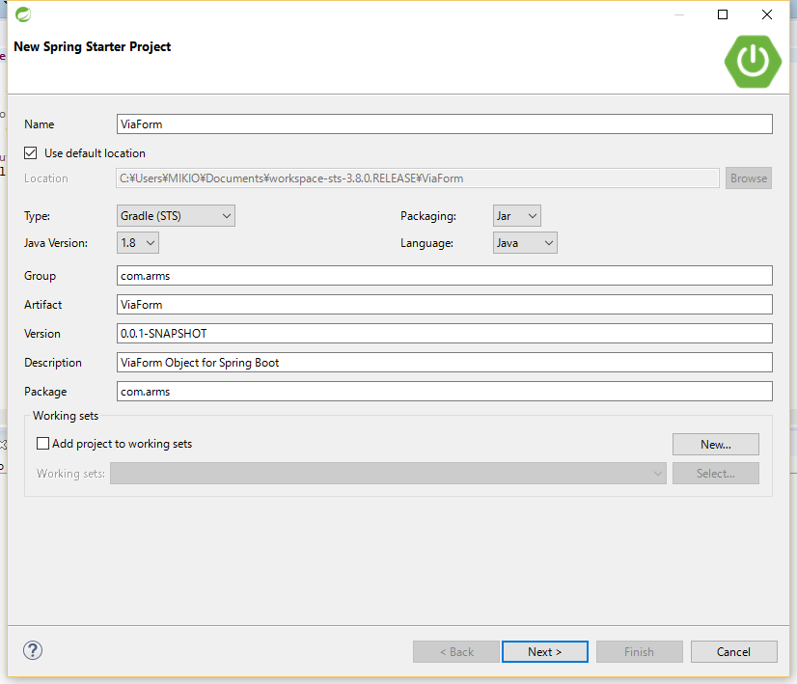
1. Start creating a project
Practical Web Development with Spring Boot
How to pass data via form object
1-1. Start Project
Open STS and File – New – Spring Starter Project
Key in necessary fields and click Next>

Slide 5
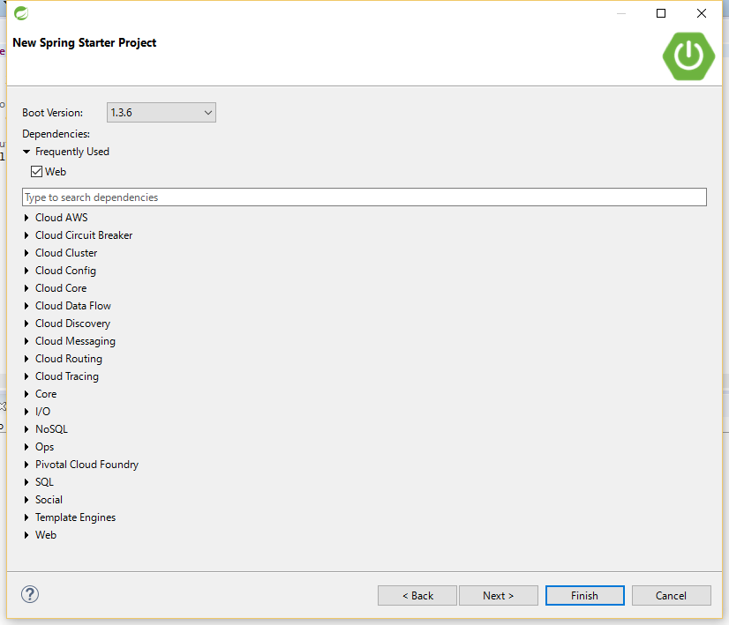
1. Start creating a project
Practical Web Development with Spring Boot
How to pass data via form object
1-1. Start Project
Check Web and click Next>

Slide 6
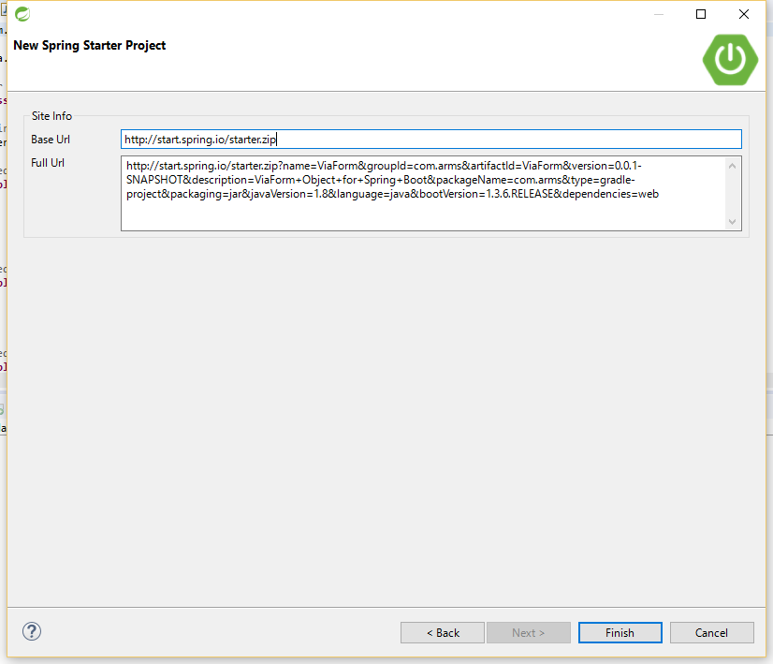
1. Start creating a project
Practical Web Development with Spring Boot
How to pass data via form object
1-1. Start Project
Click Finish

Slide 7
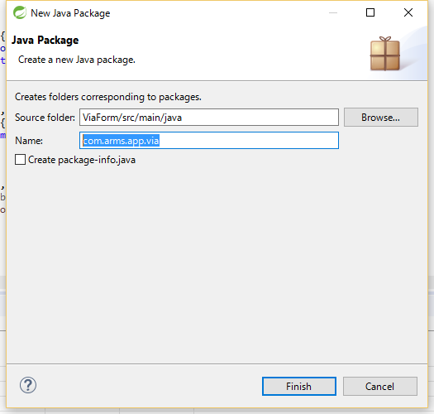
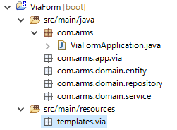
1. Start creating a project
Practical Web Development with Spring Boot
How to pass data via form object
1-1. Start Project
Create packages as below.
src/main/java
com.arms.app.via
com.arms.domain.entity
com.arms.domain.repository
com.arms.domain.service
src/main/resources
templates.via

Slide 8
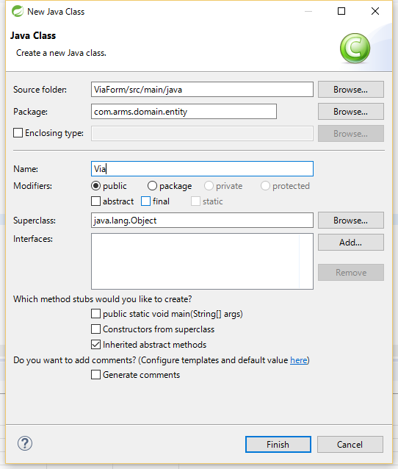
2. Create Entity and Repository
Practical Web Development with Spring Boot
How to pass data via form object
2-1. Create entity class
Right-click on com.arms.domain.entity New - Class
Name: Via
and click Finish

Slide 9
2. Create Entity and Repository
Practical Web Development with Spring Boot
How to pass data via form object
2-1. Create entity class
Resolve dependencies to create entity class
Modify build.gralde as below.
dependencies {
compile('org.springframework.boot:spring-boot-starter-data-jpa')
compile('org.springframework.boot:spring-boot-starter-thymeleaf')
compile('org.springframework.boot:spring-boot-starter-web')
compile('net.sourceforge.nekohtml:nekohtml')
runtime('org.hsqldb:hsqldb')
testCompile('org.springframework.boot:spring-boot-starter-test')
}
Modify application.properties as below.
spring.thymeleaf.mode=LEGACYHTML5
spring.thymeleaf.cache=false
spring.thymeleaf.encoding=UTF-8
Right-click on your project, and Gradle(STS) – Refresh Dependencies

Slide 10
2. Create Entity and Repository
Practical Web Development with Spring Boot
How to pass data via form object
2-1. Create entity class
Add the following code into Via.java
package com.arms.domain.entity;
import javax.persistence.Entity;
import javax.persistence.GeneratedValue;
import javax.persistence.Id;
@Entity
public class Via {
@Id @GeneratedValue
private Integer id;
private String name;
}
If you forget those dependencies to be resolved, you can’t use the annotations in the code.
dependencies {
compile('org.springframework.boot:spring-boot-starter-data-jpa')
runtime(‘org.hsqldb:hsqldb’)
………………………………………………….
}

Slide 11
2. Create Entity and Repository
Practical Web Development with Spring Boot
How to pass data via form object
2-1. Create entity class
Since you have private fields in Via.java, create getter/setter for them.
……………………..
private Integer id;
private String name;
}
Right-click on your code and display context menu.
Source – Generate getters and setters….
Eclipse(STS) has this useful function.
But in our case, let’s use lombok to auto-generate getters and setters.
Add @Data annotation and import.
import lombok.Data;
@Entity
@Data
public class Via {

Slide 12
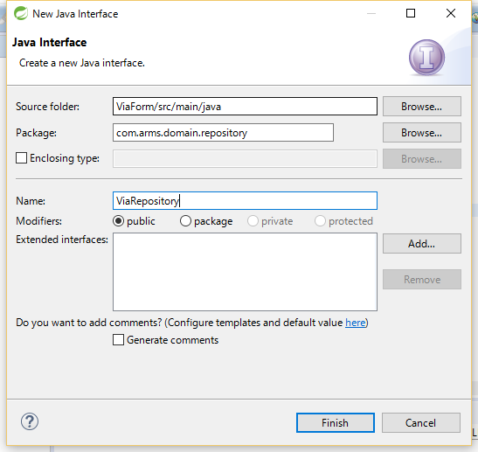

2. Create Entity and Repository
Practical Web Development with Spring Boot
How to pass data via form object
2-2. Create repository interface
Right-click on com.arms.domain.repository, New- Interface
Key in ViaRepository in the Name,
and press “Add” button to choose interface to be extended.
After adding the extended interface Press “Finish” button

Slide 13
2. Create Entity and Repository
Practical Web Development with Spring Boot
How to pass data via form object
2-2. Create repository interface
Add the following code into ViaRepository
package com.arms.domain.repository;
import org.springframework.data.jpa.repository.JpaRepository;
import org.springframework.stereotype.Repository;
import com.arms.domain.entity.Via;
@Repository
public interface ViaRepository extends JpaRepository<Via, Integer> {
}
Interface has to extend Repository and be typed to the domain class and its PK type.

Slide 14

3. Create Form
Practical Web Development with Spring Boot
How to pass data via form object
3-1. Create form object
Create a form object to receive values from text. Right-click on com.arms.app.via New - Class
Key in ViaForm in Name, and Press “Finish” button.

Slide 15
3. Create Form
Practical Web Development with Spring Boot
How to pass data via form object
3-1. Create form object
Add the following code into ViaForm.java
package com.arms.app.via;
import lombok.AllArgsConstructor;
import lombok.Data;
import lombok.NoArgsConstructor;
@Data
@AllArgsConstructor
@NoArgsConstructor
public class ViaForm {
private Integer id;
private String name;
}

Slide 16
3. Create Form
Practical Web Development with Spring Boot
How to pass data via form object
3-1. Create form object
@All and NoArgsConstructor annotations
@AllArgsConstructor
@NoArgsConstructor
public class ViaForm {
private Integer id;
private String name;
public ViaForm(Integer id, String name) {
super();
this.id = id;
this.name = name;
}
public ViaForm() {
}
}
You already have the above constructors.

Slide 17
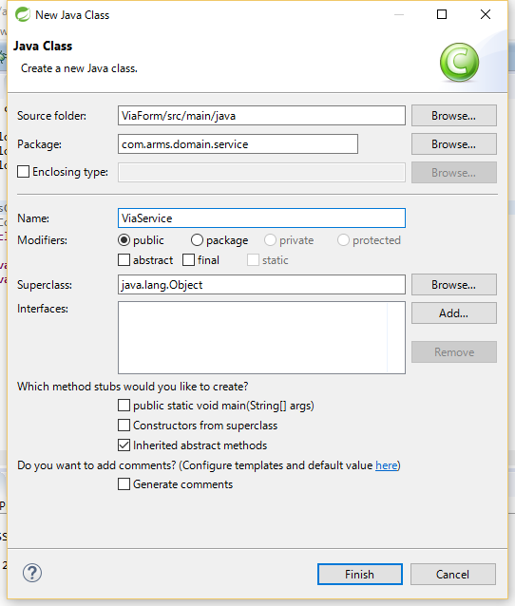
4. Create Service and Controller
Practical Web Development with Spring Boot
How to pass data via form object
4-1. Create service
Right-click on com.arms.domain.service. New - Class
Key in ViaService in Name, and press “Finish” button.

Slide 18
4. Create Service and Controller
Practical Web Development with Spring Boot
How to pass data via form object
4-1. Create service
Add the following code into ViaService.java
package com.arms.domain.service;
import java.util.List;
import org.springframework.beans.factory.annotation.Autowired;
import org.springframework.stereotype.Service;
import com.arms.app.via.ViaForm;
import com.arms.domain.entity.Via;
import com.arms.domain.repository.ViaRepository;
@Service
public class ViaService {
@Autowired
ViaRepository viaRepository;
public List<Via> findAllVia(){
return viaRepository.findAll();
}
public void save(ViaForm viaForm){
Via via = new Via();
via.setName(viaForm.getName());
viaRepository.save(via);
}
}
@Service annotation
@Autowired and access methods in Repository.
Get name value from viaForm and set it in via.
via.name = viaForm.getName();

Slide 19

4. Create Service and Controller
Practical Web Development with Spring Boot
How to pass data via form object
4-2. Create controller
Right-click on com.arms.app.via New - Class
Key in ViaController in Name, and press “Finish” button

Slide 20
4. Create Service and Controller
Practical Web Development with Spring Boot
How to pass data via form object
4-2. Create controller
Add the following code into ViaController.java
package com.arms.app.via;
import java.util.List;
import org.springframework.beans.factory.annotation.Autowired;
import org.springframework.stereotype.Controller;
import org.springframework.ui.Model;
import org.springframework.web.bind.annotation.ModelAttribute;
import org.springframework.web.bind.annotation.RequestMapping;
import org.springframework.web.bind.annotation.RequestMethod;
import com.arms.domain.entity.Via;
import com.arms.domain.service.ViaService;
@Controller
public class ViaController {
@Autowired
ViaService viaService;
@RequestMapping("/")
public String index(Model model){
List<Via> viaList = viaService.findAllVia();
model.addAttribute("viaList", viaList);
return "via/index";
}
Continue on next page

Slide 21
4. Create Service and Controller
Practical Web Development with Spring Boot
How to pass data via form object
4-2. Create controller
Add the following code into ViaController.java
@RequestMapping(value = "/via", method = RequestMethod.GET)
public String via(Model model){
model.addAttribute("viaForm", new ViaForm());
return "via/via";
}
@RequestMapping(value = "/via", method = RequestMethod.POST)
public String create(@ModelAttribute ViaForm viaForm){
viaService.save(viaForm);
return "redirect:/via";
}
}

Slide 22
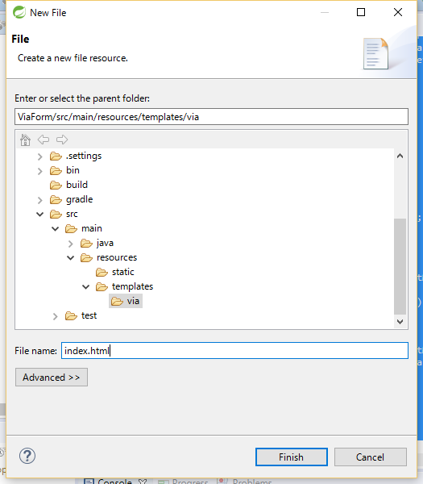
5. Create View
Practical Web Development with Spring Boot
How to pass data via form object
5-1. Create view
Right-click on templates.via New - File
Key in index.html in File name and press “Finish” button.

Slide 23
5. Create View
Practical Web Development with Spring Boot
How to pass data via form object
5-1. Create view
Add the following code into index.html
<!DOCTYPE html>
<html xmlns="http://www.w3.org/1999/xhtml"
xmlns:th="http://www.thymeleaf.org">
<head>
<meta http-equiv="Content-Type" content="text/html; charset=UTF-8">
<title>Input Form</title>
</head>
<body>
<div th:each="via: ${viaList}">
<p th:text="${via.name}">name</p>
</div>
</body>
</html>

Slide 24
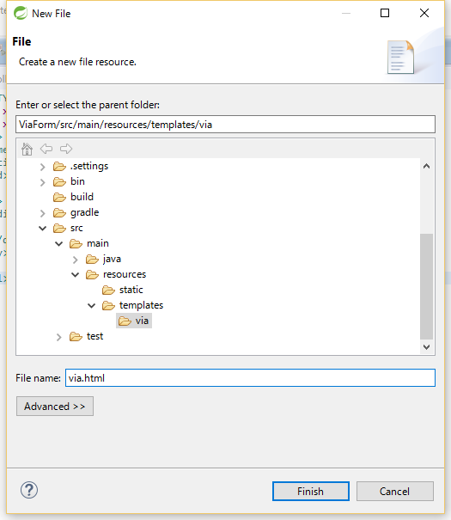
5. Create View
Practical Web Development with Spring Boot
How to pass data via form object
5-1. Create view
Right-click on templates.via New - File
Key in via.html in File name and press “Finish” button.

Slide 25
5. Create View
Practical Web Development with Spring Boot
How to pass data via form object
5-1. Create view
Add the following code into via.html
<!DOCTYPE html>
<html xmlns="http://www.w3.org/1999/xhtml"
xmlns:th="http://www.thymeleaf.org">
<head>
<meta http-equiv="Content-Type" content="text/html; charset=UTF-8">
<title>input form</title>
</head>
<body>
<form th:action="@{/via}" th:object="${viaForm}" method="POST">
<input th:field="*{name}" id="name" type="text" name="name">
<button type="submit">Send</button>
</form>
</body>
</html>

Slide 26
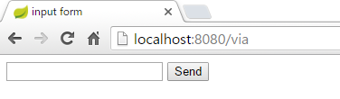
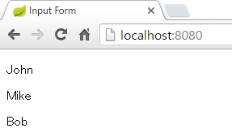
5. Create View
Practical Web Development with Spring Boot
How to pass data via form object
5-1. Create view
Start your project and access localhost:8080/via
Send a few records and access localhost:8080

Slide 27
6. Code Explanation
Practical Web Development with Spring Boot
How to pass data via form object
6-1. form object
Let’s see how form object is used.
access via.html
@RequestMapping(value = "/via", method = RequestMethod.GET)
public String via(Model model){
model.addAttribute("viaForm", new ViaForm());
return "via/via";
}
viaForm object goes to via.html
<form th:action="@{/via}" th:object="${viaForm}" method="POST">
<input th:field="*{name}" id="name" type="text" name="name">
<button type="submit">Send</button>
</form>
viaForm.name is received as args
@RequestMapping(value = "/via", method = RequestMethod.POST)
public String create(@ModelAttribute ViaForm viaForm){
viaService.save(viaForm);
return "redirect:/via";
}
Saved by save(viaForm) method

Slide 28
6. Code Explanation
Practical Web Development with Spring Boot
How to pass data via form object
6-1. form object
Thymeleaf syntax
via.html
<form th:action="@{/via}" th:object="${viaForm}" method="POST">
<input th:field="*{name}" id="name" type="text" name="name">
<button type="submit">Send</button>
</form>
With th:object, it can abbreviate model object name part
<form th:action="@{/via}" th:object="${viaForm}" method="POST">
<input th:field="${viaForm.name}" id="name" type="text" name="name">
<button type="submit">Send</button>
</form>
index.html
<div th:each="via: ${viaList}">
<p th:text="${via.name}">name</p>
</div>
This has the same result, but useful when there are many fields
<div th:each="via: ${viaList}" th:object=${via}>
<p th:text="*{name}">name</p>
</div>

Slide 29
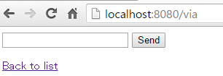
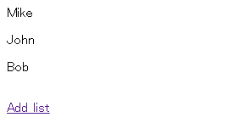
7. Practice
Practical Web Development with Spring Boot
How to pass data via form object
7-1. Create link button
Create link button on via.html and index.html
via.html : Back to list button to go to index.html
index.html : Add list button to go to via.html

Slide 30

Your Idea Leads Your Ideals
homepage: http://arms-asia.com/
facebook: https://www.facebook.com/arms.asia?fref=ts
Notes:
If you follow document, next class is very easy

